Slide 1

B-13 THAT’S MY SPOT
-Srividya Balaji
-Shweta Chaudhary
-Shubham Metha
-Shwetha Narayanan
-Sonal Thube
Notes:
Hi prof , this is Shubham and we are team b-13. That’s my spot is a parking app which allows users to find a parking spot at ease.

Slide 2
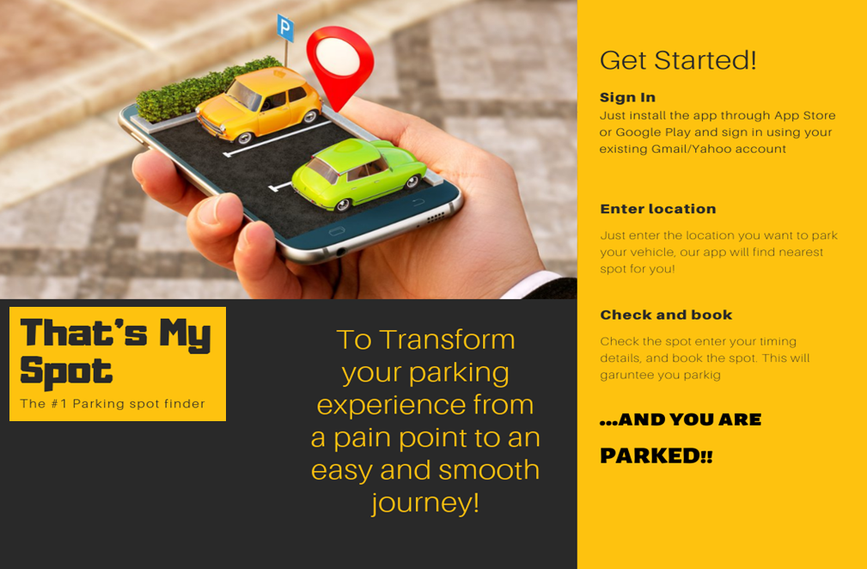
Notes:
Every day, millions of people look to park their cars on the street and often spend 5-10 minutes looking for a parking spot in the permitted area.
Apart from time, there can be confusing sign boards which may lead you to park in a wrong spot. That is where the motivation for this project came up from.
That’s my spot aims to provide a solution for this problem by getting the time left on the parking meter to show the person looking for parking if the meter is unpaid and show if any spot will be vacant in a span of 15 minutes. Using the app, users can also book a spot in a parking garage prior to their arrival.
Sonal will be taking over from the next slide.

Slide 3
Unmet Needs
Accurate Surge pricing
Piggyback paid spots
Reminder facility
Monthly plans
Overnight booking
Notes:
Seeking a vacant parking space during peak hours in areas like Hospitals, Hotels & Shopping Centers, Airports, Universities, and Exhibitions & Convention Center has always been frustrating for many drivers.
Sometimes ride requests increase unexpectedly.
Surge pricing is designed to restore the balance between driver availability and rider demand.
Piggybacking spots- using another spot when it has been vacated earlier
Reminder facility: Reminding a user that the booking time is about to end
Monthly plans: booking a spot for a whole month
Overnight booking: booking overnight

Slide 4
Customer Segment
Travelling Users
Vehicle owners
Parking lot owners
Car rental owners
Cab drivers
Tourists and travelers
Notes:
The target customer segment in this problem are the common people and drivers who are eligible for driving in United States or any other countries that have similar parking system and face issues of parking within that area.
Shweta Chaudary will be continu….

Slide 5


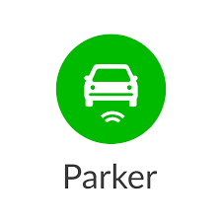



Existing Solutions and why they aren’t good enough
Surge Pricing
History Tracking
Advanced Booking
Notes:
Advanced booking: Although most of the existing apps provide an option to book a parking spot, they don’t provide the option to book it in advance at a cheaper price.
History tracking: tracking previously parked spots
Surge pricing: The existing apps provide inaccurate pricing for the parking spots when there are price surges, say if an event is going on.

Slide 6
Market Size
Notes:
•60% of the people in United States are looking for parking daily•
$72.7 Billion is the annual amount spent on parking
•Americans pay around $20 Billion for overpaying in parking
Srividya will be conti..

Slide 7
Risks
Privacy
Legal
Misuse
Permission
Cost
Competitor
Notes:
Privacy concerns:•App users may be concerned about sharing their car license plate number and credit card information
Legal concerns:•We should make sure not to violate any parking laws and usage of information submitted by users while registration of their information in the app
Misuse of facility:•Some users can misuse the app’s facility by parking in the reserved spot of someone else. There should be a OTP for users to enter in the app for that particular spot for the meter to start as and when they park
Permission concerns:•Obtaining permission from the Government to implement this design as it has to be approved by the Police department as well
Cost and promotions:•The cost of implementing this idea without sponsor could be a concern. The cost involved in promotions and advertisement should be taken into consideration
Competitor concerns:•Existing applications that already have a customer base might try to implement a similar idea after the launch of our product. Customers who don’t know our product might decide to stick to using the old app
Shwetha Narayanan will be conti…

Slide 8
Use Case
Payment
Locate
Book
Extend
Update
Notes:
Let us see our use cases now:
Making a payment for a parking spot: lets say Laura is driving around the city and is looking to park her car in one of the metered parking spots and she does not have enough quarters. She can use That’s my Spot app to pay for the parking spot via digital payment
Ability to locate a parking spot: Srinath is visiting central park in New York. He has been driving around the streets multiple times to find a spot. For him to be able to park his car hassle free and be able to enjoy his sight-seeing happily, he can use That’s my Spot app to find where there are empty parking spots able to reach there using its location.
Ability to book a parking spot: Thara is planning to visit a new city for her interview. She can pre book her parking spot using that’s my spot app so that she doesn’t have to spend a lot of time looking for a parking spot
Extending time in a parking spot: Abbey has reserved and paid for her metered parking spot for 2 hours and now knows that she needs the spot for another hour. She can use That’s my Spot to pay for another extra hour and avoid getting a parking ticket
Update the parking spot availability : Matthew has pre-booked his parking spot in Cambridge for 3 hours for his doctor’s appointment. Now, his work is over in 2 hours. He can use That’s my Spot to update the information so that the next user will be able to see the spot being available for them to use.
Takeaway:
Everyday, thousands of people waste time in traffic and in searching for a parking spot. This app is a way to help people to have little more time to complete their daily goals in the most efficient way!
Thank you for watching!!

